Slide 1
UI Possible Screens

Slide 2
Buccaneer title and logo
This is the first buccaneer requirement, 'it will prompt the users for the name of each of the four players'.

Slide 3
Buccaneer
Image of pirates
Image of pirates
Image of pirates
Image of pirates
Player 1
Player 2
Player 3
Player 4
Enter name
Enter name
Enter name
Enter name
Continue
This is the first buccaneer requirement, 'it will prompt the users for the name of each of the four players'.

Slide 4

Image of pirates
Player Name
The requirements state that the players each must be randomly assigned a port.

Slide 5
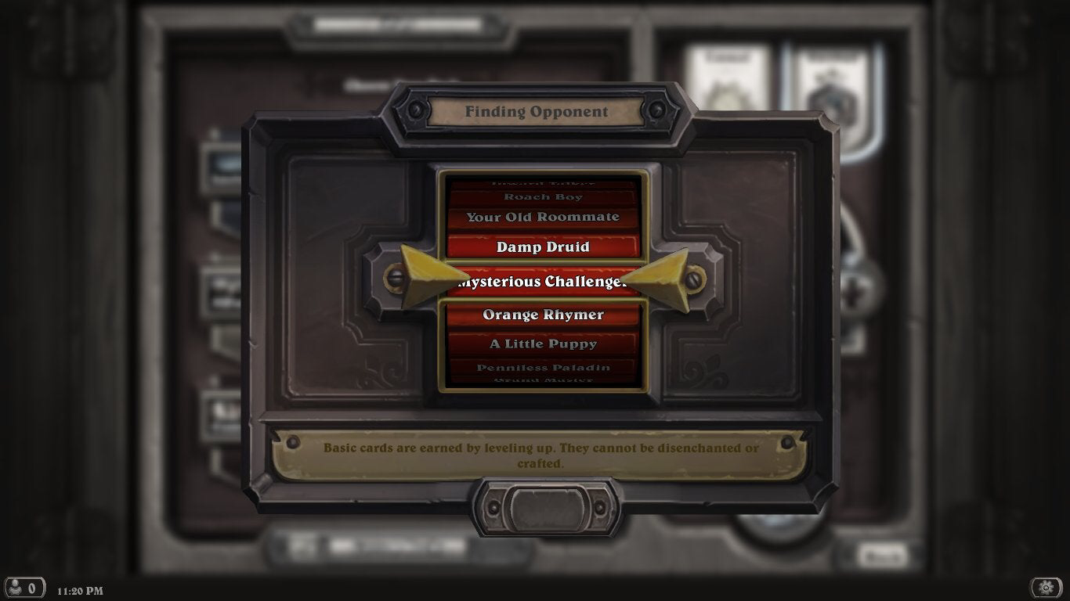

Slide 6
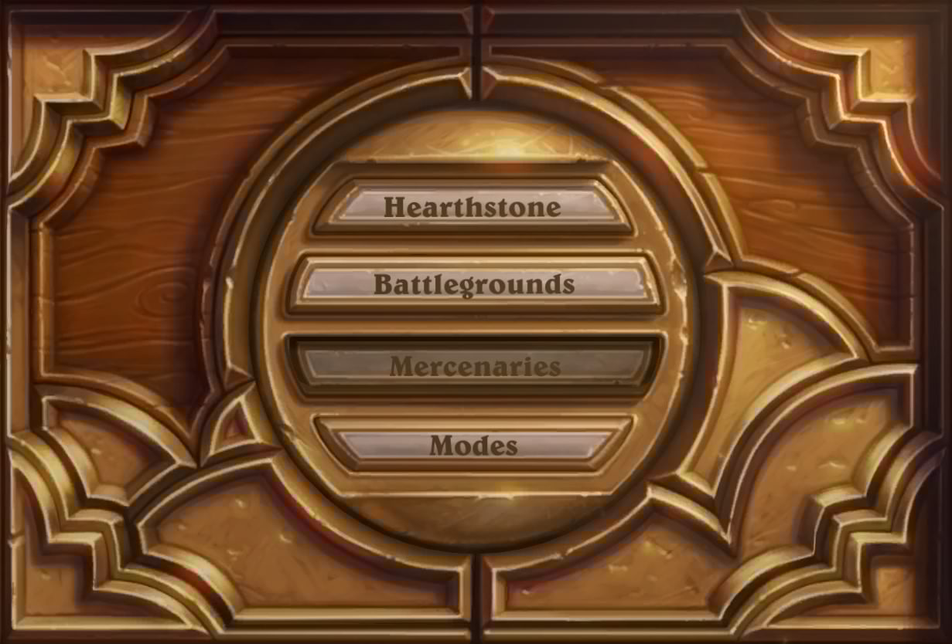

Slide 7












The London in yellow indicates that, that’s where the current players port is

Slide 8























Slide 9










So as the grid is quite small I think the UI should be very concealed and can be shown when the user wants to see it. For example to see the crew cards there will be a pull tab at the bottom of the screen like shown

Slide 10











This displays the player being dealt the crew cards on startup

Slide 11


This displays the players tresure

Slide 12
This displays the players chance cards that they can keep
Doubloons (Keep this card). This card may be traded for crew or treasure up to value 5 in any port you visit.

Slide 13

Phase 1 (Move)

Slide 14
This is phase 1 (moving), in this slide the player has selected somewhere to move within the guidelines displayed. After this is selected the move button on the right should be pressed to confirm the movement

Slide 15
This shows the boat after it has moved

Slide 16

Phase 2 (Turn)

Slide 17





This is phase 2 (turning), this phase is where the player can select the direction of the ship then confirm using the confirm button. In this slide I have also added a rules button.

